Slide 1

CSE3151
Computer Networks
(Session 2018-19)
Dr. Asif Zaman
Associate Professor, CSE, RU

Slide 2
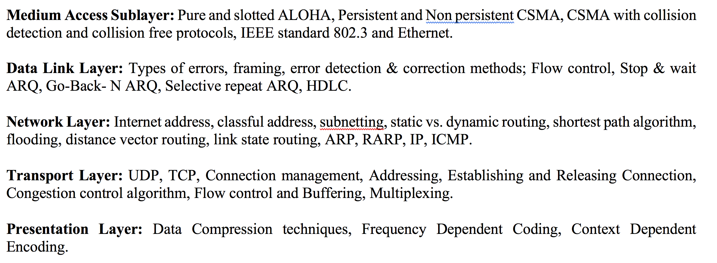
Course Contents

Slide 3
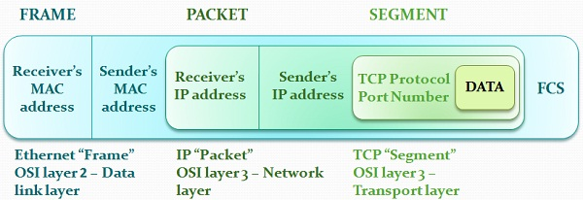
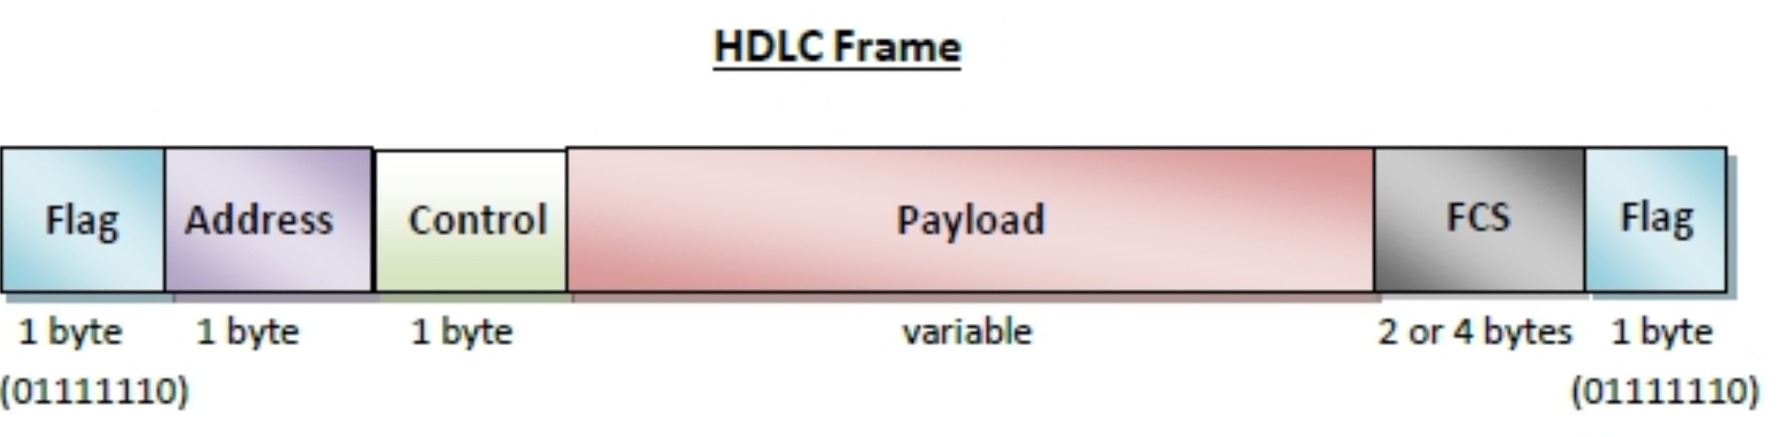
The Story

Slide 4

What is an IP Address?
An IP address is a 32-bit address.
The IP addresses are unique.

Slide 5
Address Space
An address space defines a range of discrete addresses, each of which may correspond to a network host, peripheral device, disk sector, a memory cell or other logical or physical entity.
…………..
…………..
addr1
addr15
addr2
…………..
…………..
…………..
addr41
addr226
addr31
…………..
…………..

Slide 6
Address Space Regulation
…………..
addr15
The address space in a protocol
That uses N-bits to define an
Address is:
2^{N}
addr2
…………..
…………..
…………..
addr41
addr226
addr31
…………..
…………..

Slide 7
IPv4 address space
The address space of IPv4 is
2³² or 4,294,967,296.
429 Crore+

Slide 8
Binary Notation
11000000 10101000 00000000 00000001
192 . 168 . 0 . 1

Slide 9

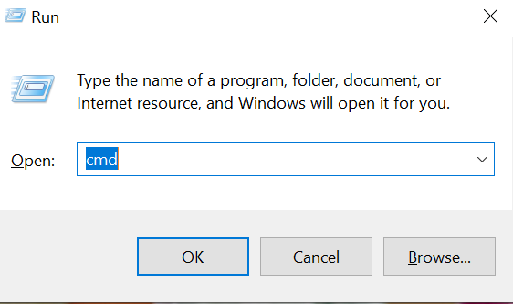
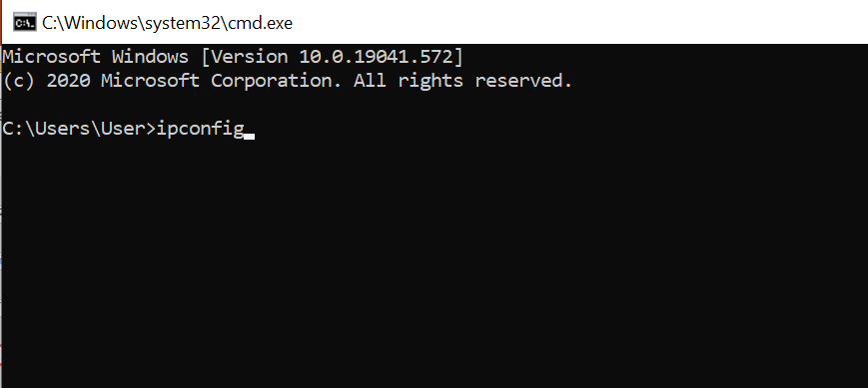
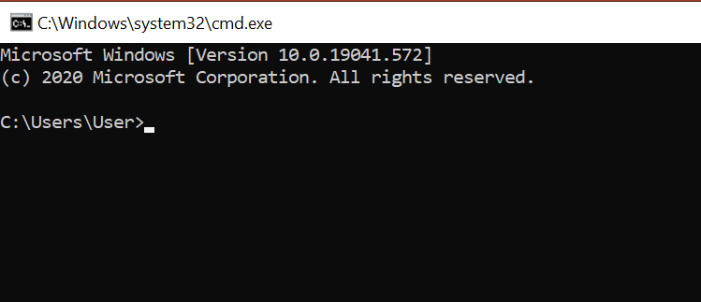
+ R

Slide 10
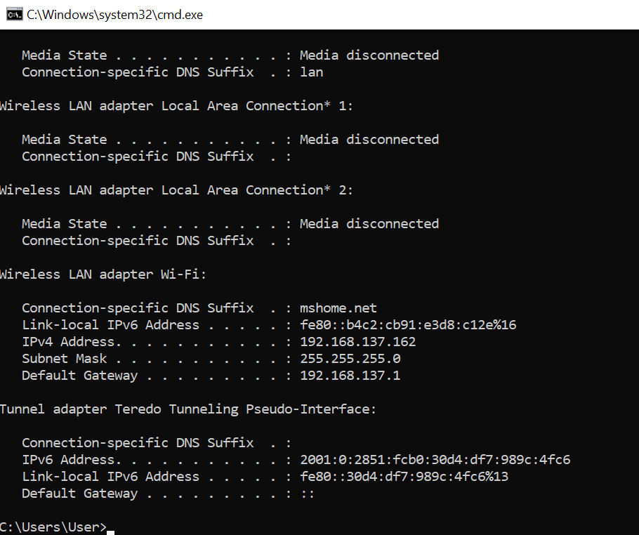

Slide 11
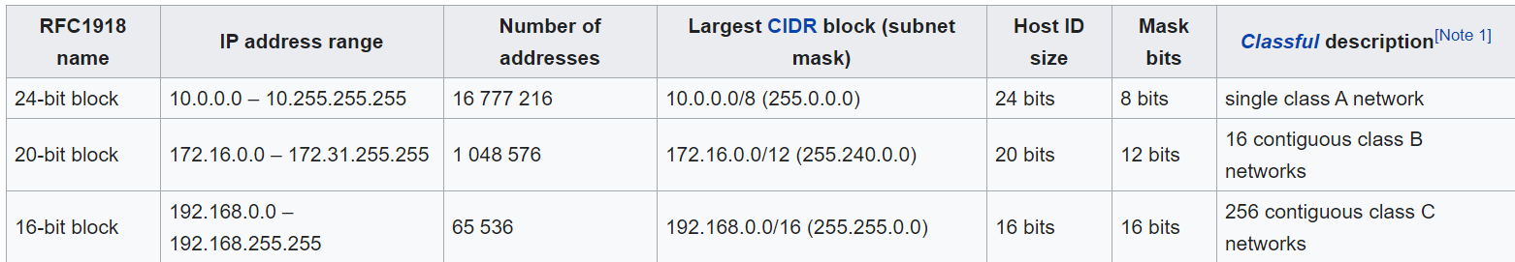
A Request for Comments (RFC) is a publication from the Internet Society (ISOC) and its associated bodies, most prominently the Internet Engineering Task Force (IETF), the principal technical development and standards-setting bodies for the Internet.

Slide 12
CLASSFUL
ADDRESSING

Slide 13
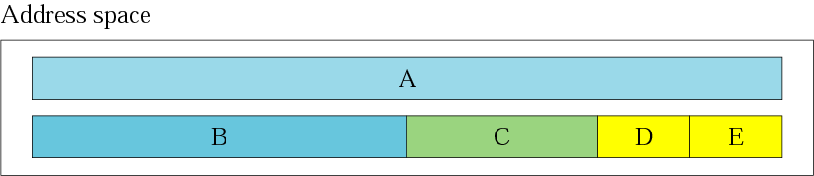
Occupation of the address space
In classful addressing the address space is
divided into 5 classes:
A, B, C, D, & E

Slide 14
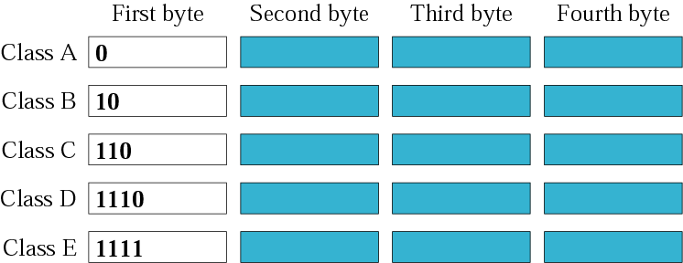
Finding the class in binary notation

Slide 15
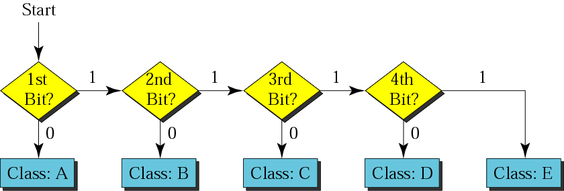
Finding the address class

Slide 16
Example
Show that Class A has
2³¹ = 2,147,483,648 addresses
214 Crore+
01000000 10101000 00000000 00000001

Slide 17
Example
Find the class of the following IP addresses
00000001 00001011 00001011 11101111
11000001 00001011 00001011 11101111
00000001 00001011 00001011 11101111
1st is 0, hence it is Class A
11000001 00001011 00001011 11101111
1st and 2nd bits are 1, and 3rd bit is 0 hence, Class C

Slide 18
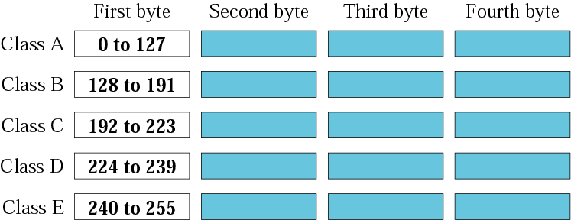
Finding the class in decimal notation
00000000 → 01111111 (127)
10000000 (128) → 10111111 (191)
11000000 (192) → 11011111 (223)

Slide 19
Example
Find the class of the following addresses
158.223.1.108
227.13.14.88
158.223.1.108
1st byte = 158 (128<158<191) class B
227.13.14.88
1st byte = 227 (224<227<239) class D

Slide 20
Port number
Default Port:1-1024
Ping: 7
DHCP: 68
158.128.1.108:25
the for octet before colon is the IP address
The number of colon (25) is the port number
16-bit integer, so 65535.

Slide 21
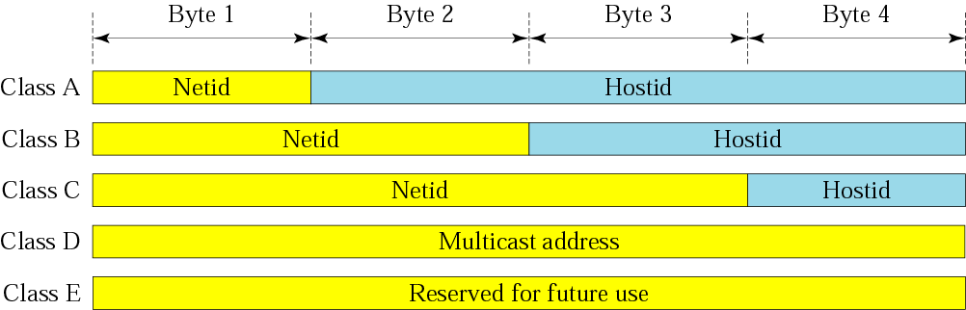
Netid and hostid

Slide 22
73.X.X.X
Router

Slide 23
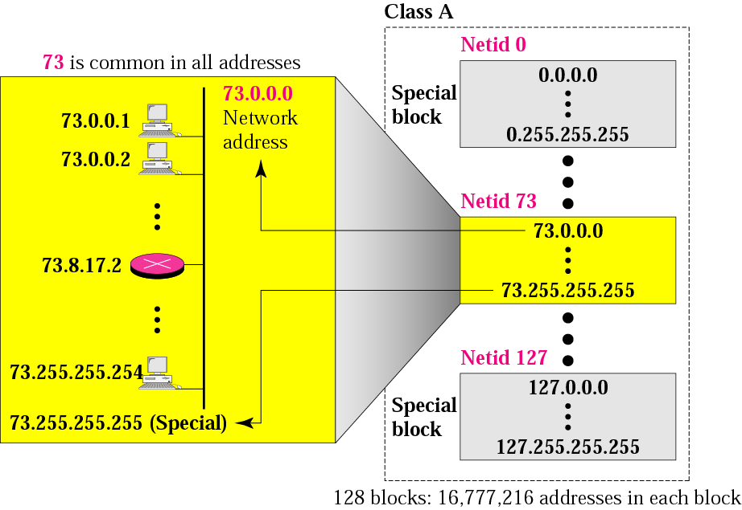
Blocks in class A

Slide 24
Millions of class A addresses are wasted.

Slide 25
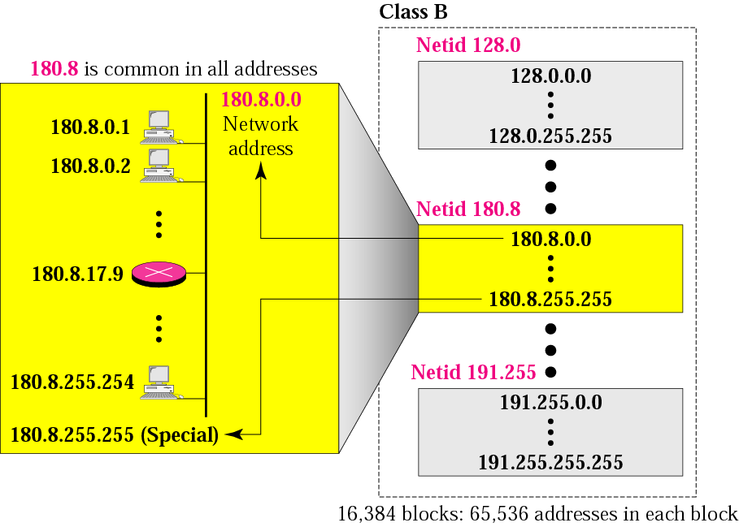
Blocks in class B

Slide 26
Many class B addresses are wasted.

Slide 27
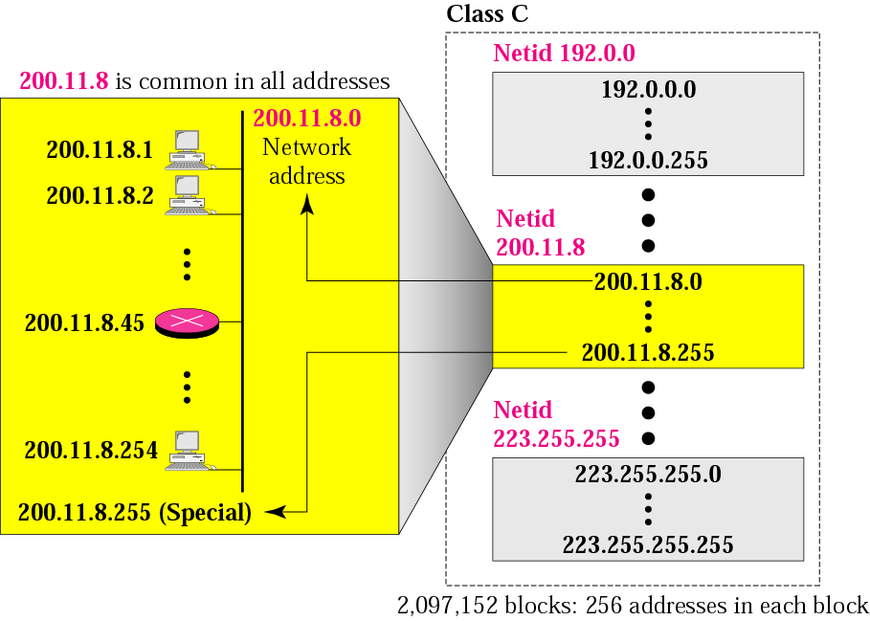
Blocks in class C

Slide 28
The number of addresses in a class C block is smaller than the needs of most organizations.

Slide 29
Class D addresses are used for multicasting; there is only one block in this class.

Slide 30
Class E addresses are reserved for special purposes; most of the block is wasted.

Slide 31
Network Addresses
The network address is the first address.
The network address defines the network to the rest of the Internet.
Given the network address, we can find the class of the address, the block, and the range of the addresses in the block

Slide 32
In classful addressing, the network address (the first address in the block) is the one that is assigned to the organization.

Slide 33
Mask
A mask is a 32-bit binary number.
The mask is ANDeD with IP address to get
The block address (Network address)
Mask And IP address = Block Address

Slide 34
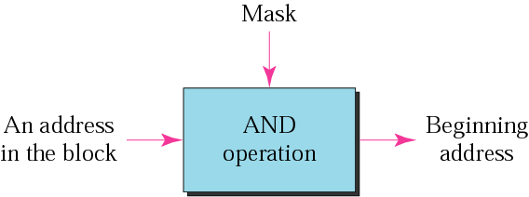
Masking concept

Slide 35
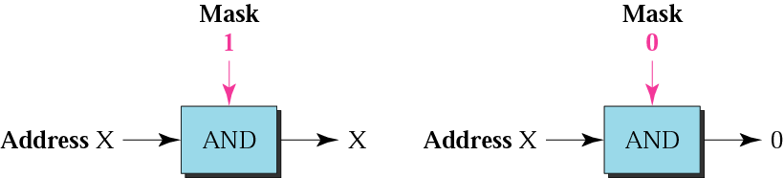
AND operation

Slide 36
The network address is the beginning address of each block. It can be found by applying the default mask to any of the addresses in the block (including itself). It retains the netid of the block and sets the hostid to zero.

Slide 37
Default Mask
Class A default mask is 255.0.0.0
Class B default mask is 255.255.0.0
Class C Default mask 255.255.255.0

Slide 38
Subnetting and Classless Addressing

Slide 39
SUBNETTING

Slide 40
Note
Subnetting is done by borrowing bits from the host part and add them the network part

Slide 41
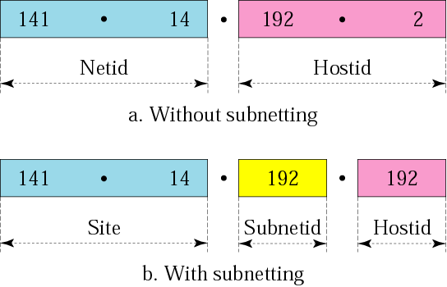
Addresses in a network with and without subnetting

Slide 42
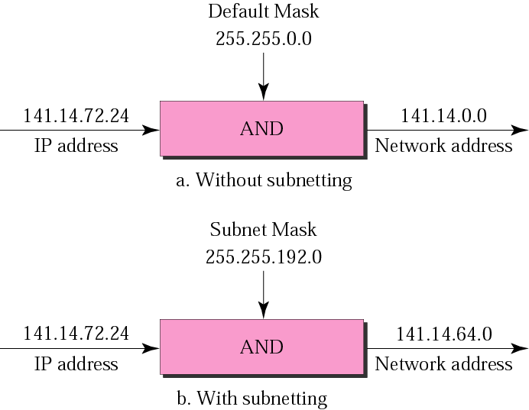
Default mask and subnet mask
72 =01001000
=11000000
01000000=64

Slide 43
Finding the Subnet Address
Given an IP address, we can find the subnet address the same way we found the network address. We apply the mask to the address. We can do this in two ways: straight or short-cut.

Slide 44
Straight Method
In the straight method, we use binary notation for both the address and the mask and then apply the AND operation to find the subnet address.

Slide 45
Example
What is the subnetwork address if the destination address is 200.45.34.56 and the subnet mask is 255.255.240.0?

Slide 46
Solution
11001000 00101101 00100010 00111000
11111111 11111111 11110000 00000000
11001000 00101101 00100000 00000000
The subnetwork address is 200.45.32.0.

Slide 47
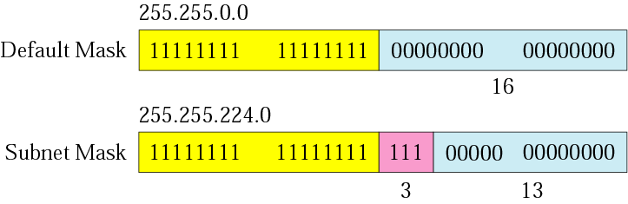
Comparison of a default mask and
a subnet mask

Slide 48
The number of subnets must be a power of 2.

Slide 49
Example
A company is granted the site address 201.70.64.0 (class C). The company needs six subnets. Design the subnets.
Solution
The number of 1s in the default mask is 24 (class C).

Slide 50
201.70.64.0/24
255.255.255.0
201.70. 01000000.0000 0000
My Company
Network
R1
R
R2

Slide 51
201.70. 01000000.0000 0000
My Company
Network
R

Slide 52
Solution (Continued)
The company needs six subnets.
This number 6 is not a power of 2.
The next number that is a power of 2 is 8 (2³).
We need 3 more 1s in the subnet mask.
The total number of 1s in the subnet mask is 27 (24 + 3).
The total number of 0s is 5 (32 - 27). The mask is

Slide 53
Solution (Continued)
11111111 11111111 11111111 11100000
or
255.255.255.224
The number of subnets is 8.
The number of addresses in each subnet is 2⁵ (5 is the number of 0s) or 32.

Slide 54
201.70. 64.000 00000
201.70. 64.001 00000
201.70. 64.010 00000
201.70. 64.111 00000
: 201.70.64.0
: 201.70.64.32
: 201.70.64.64
: 201.70.64.224
My Company
Network
R

Slide 55
201.70. 64.000 00000
201.70. 64.000 00001
201.70. 64.000 00010
201.70. 64.000 00011
201.70. 64.000 11111
: 201.70.64.1
: 201.70.64.2
: 201.70.64.3
: 201.70.64.31

Slide 56
201.70. 64.001 00000
201.70. 64.001 00001
201.70. 64.001 00010
201.70. 64.001 00011
201.70. 64.001 11111
: 201.70.64.33
: 201.70.64.34
: 201.70.64.35
: 201.70.64.63

Slide 57
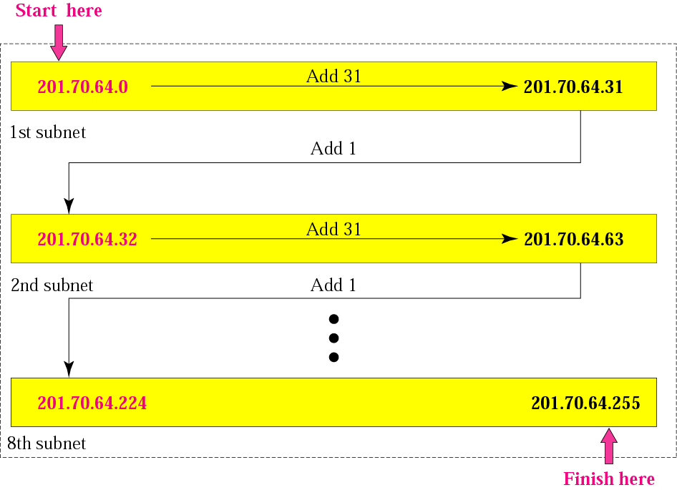
Example

Slide 58
Example
A company is granted the site address 181.56.0.0 (class B). The company needs 1000 subnets. Design the subnets.
Solution
The number of 1s in the default mask is 16 (class B).

Slide 59
Solution (Continued)
The company needs 1000 subnets. This number is not a power of 2. The next number that is a power of 2 is 1024 (2¹⁰). We need 10 more 1s in the subnet mask.
The total number of 1s in the subnet mask is 26 (16 + 10).
The total number of 0s is 6 (32 − 26).

Slide 60
The mask is
11111111 11111111 11111111 11000000
or
255.255.255.192.
The number of subnets is 1024.
The number of addresses in each subnet is 2⁶ (6 is the number of 0s) or 64.
See next slide

Slide 61
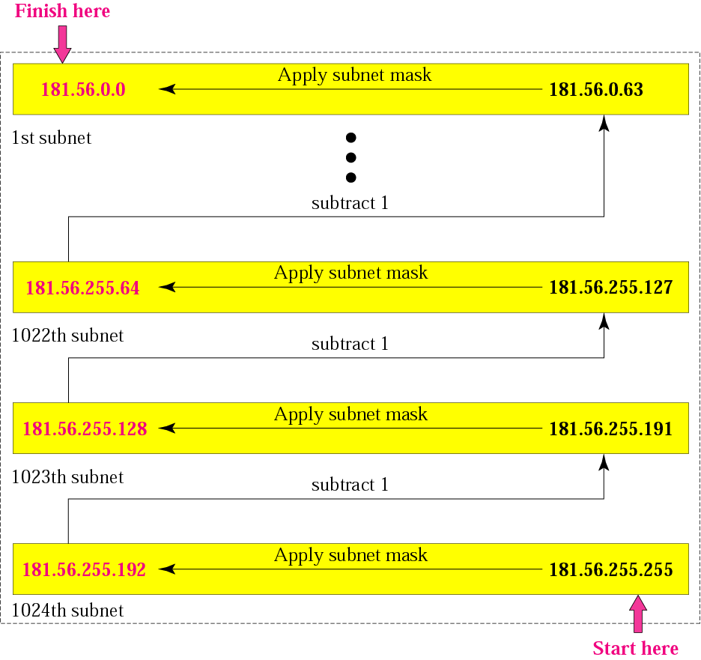

Slide 62
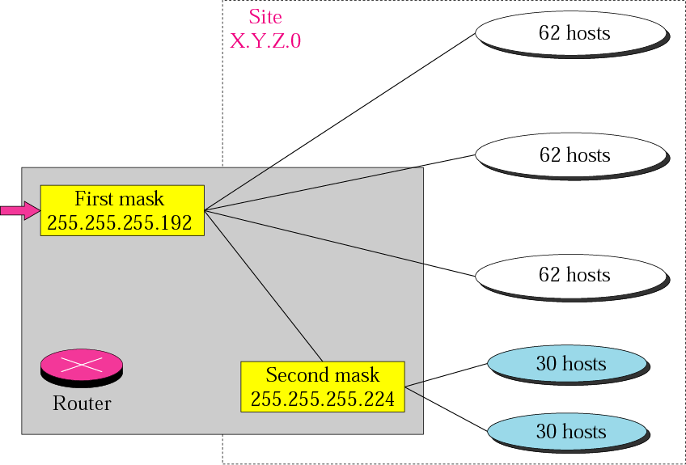
Variable-length subnetting

Slide 63
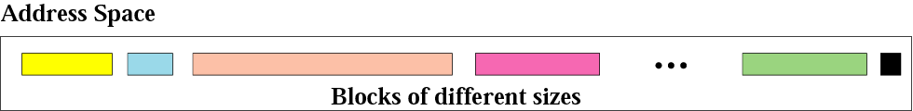
Variable-length blocks

Slide 64
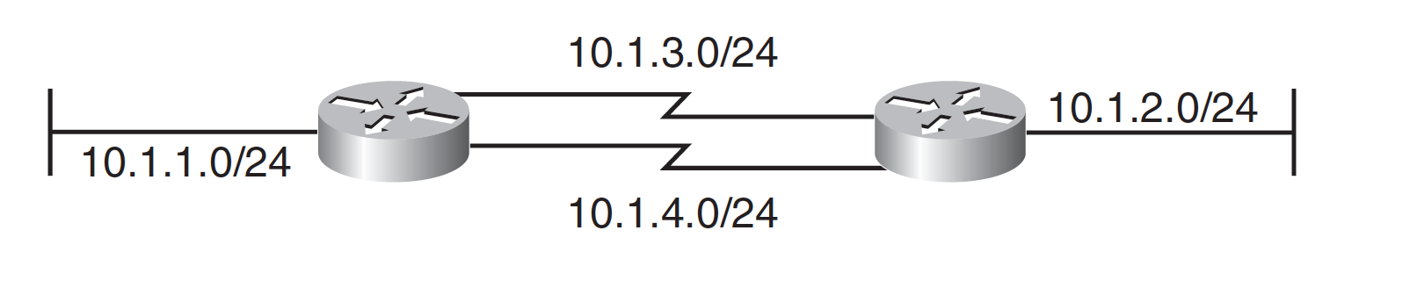
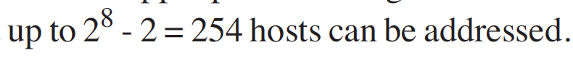
Variable-Length Subnet Masks
Variable-Length Subnet Masks –VLSM

Slide 65
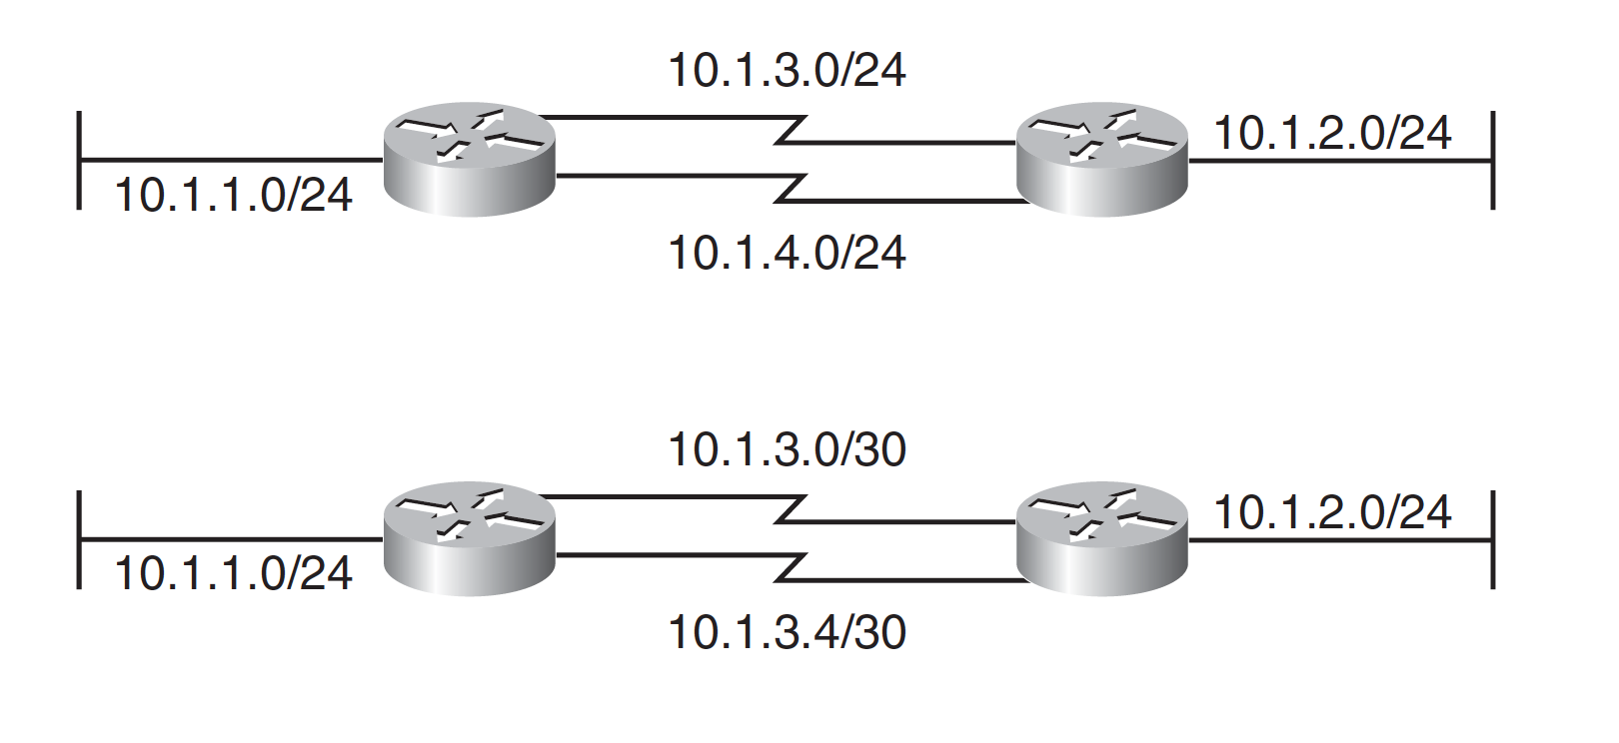
Variable-Length Subnet Masks

Slide 66
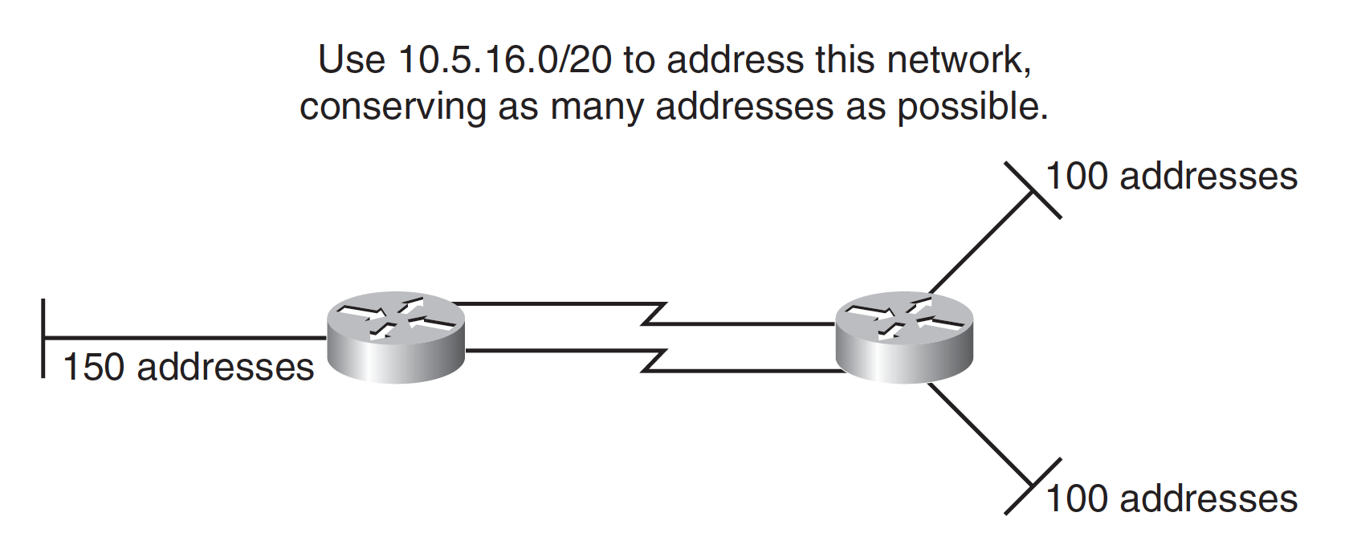
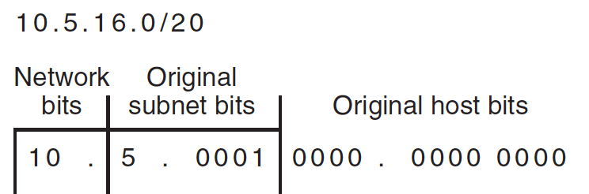
Variable-Length Subnet Masks
If you use any addresses from a subnet, that subnet should not be further subnetted.

Slide 67
For the left LAN, 150 addresses are needed;
rounding up to the next power of 2 gives 256.
Because 2⁸ = 256, 8 host bits are needed.
For the other two LANs, 100 addresses are needed;
rounding up to the next power of 2 gives 128.
Because 2⁷ = 128, 7 host bits are needed for each LAN.
The WANs require 2 host bits each.

Slide 68
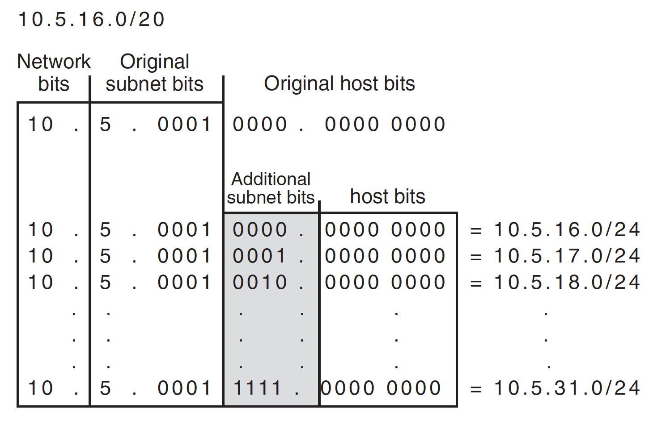
Because at most 8 host bits are needed, the 10.5.16.0/20 address can be further subnetted into sixteen /24 subnets (leaving 8 host bits)

Slide 69
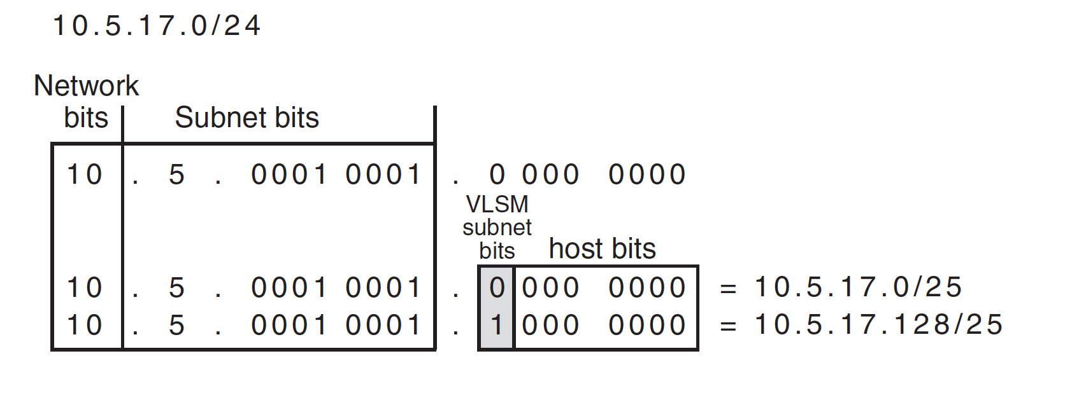

Slide 70
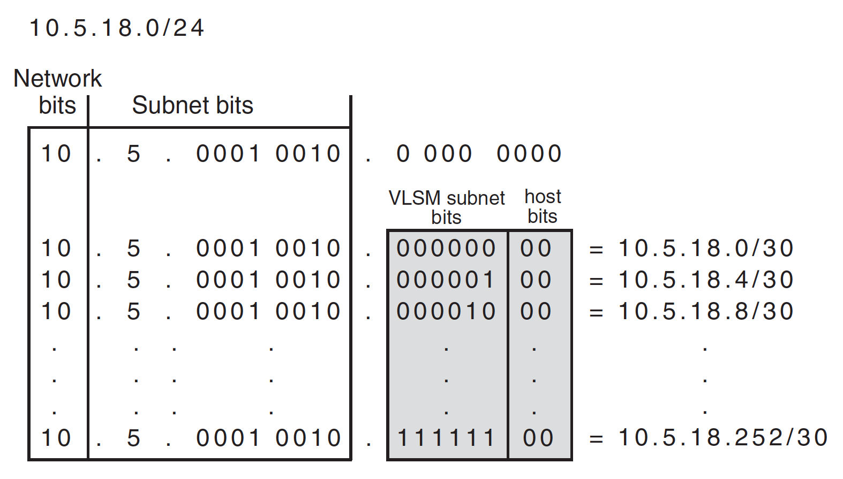
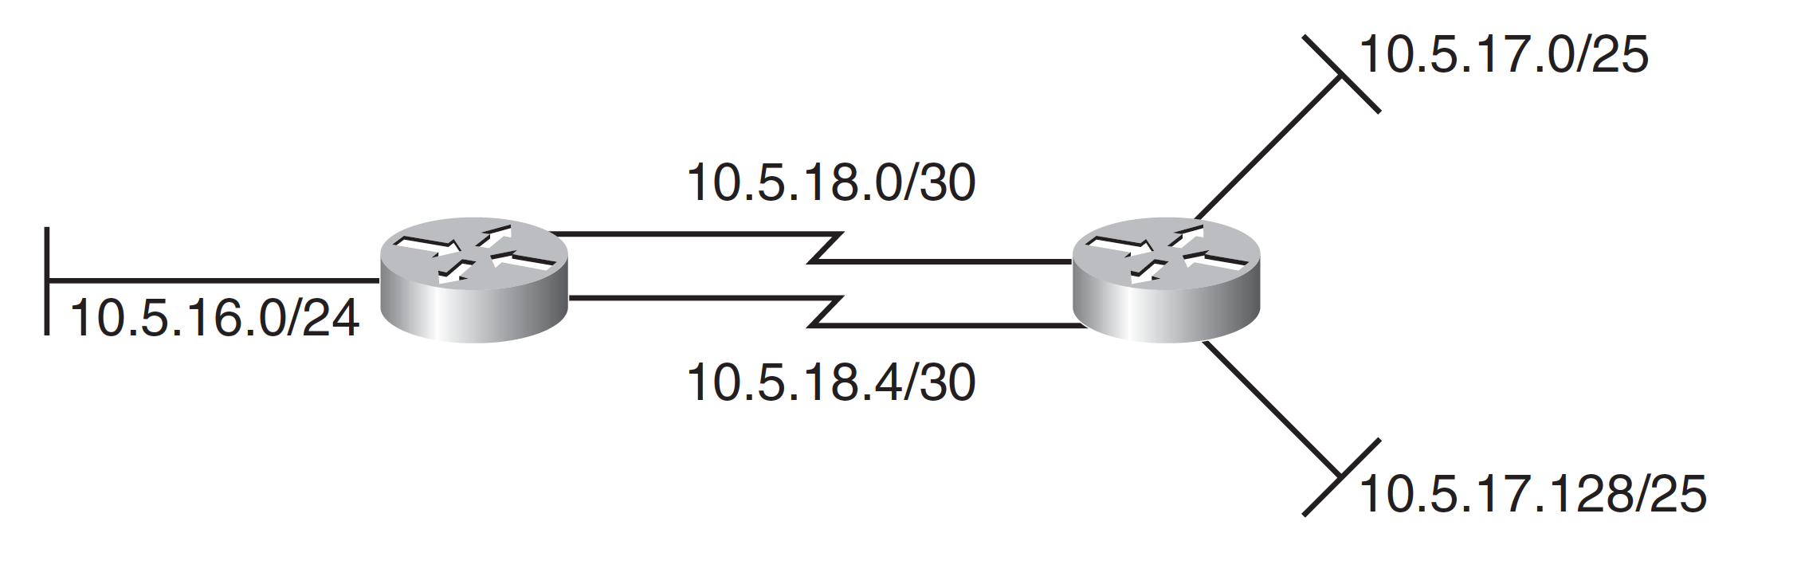

Slide 71
Report Submission
150 addresses
100 addresses
150 addresses

Slide 72
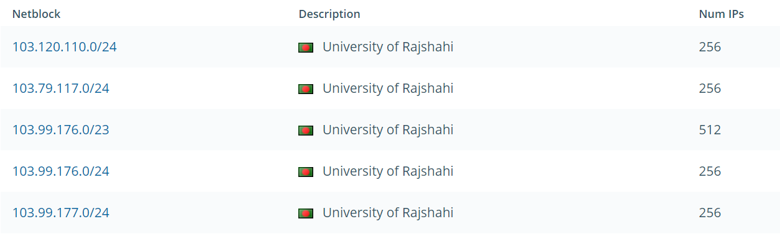
RU IP Block

Slide 73
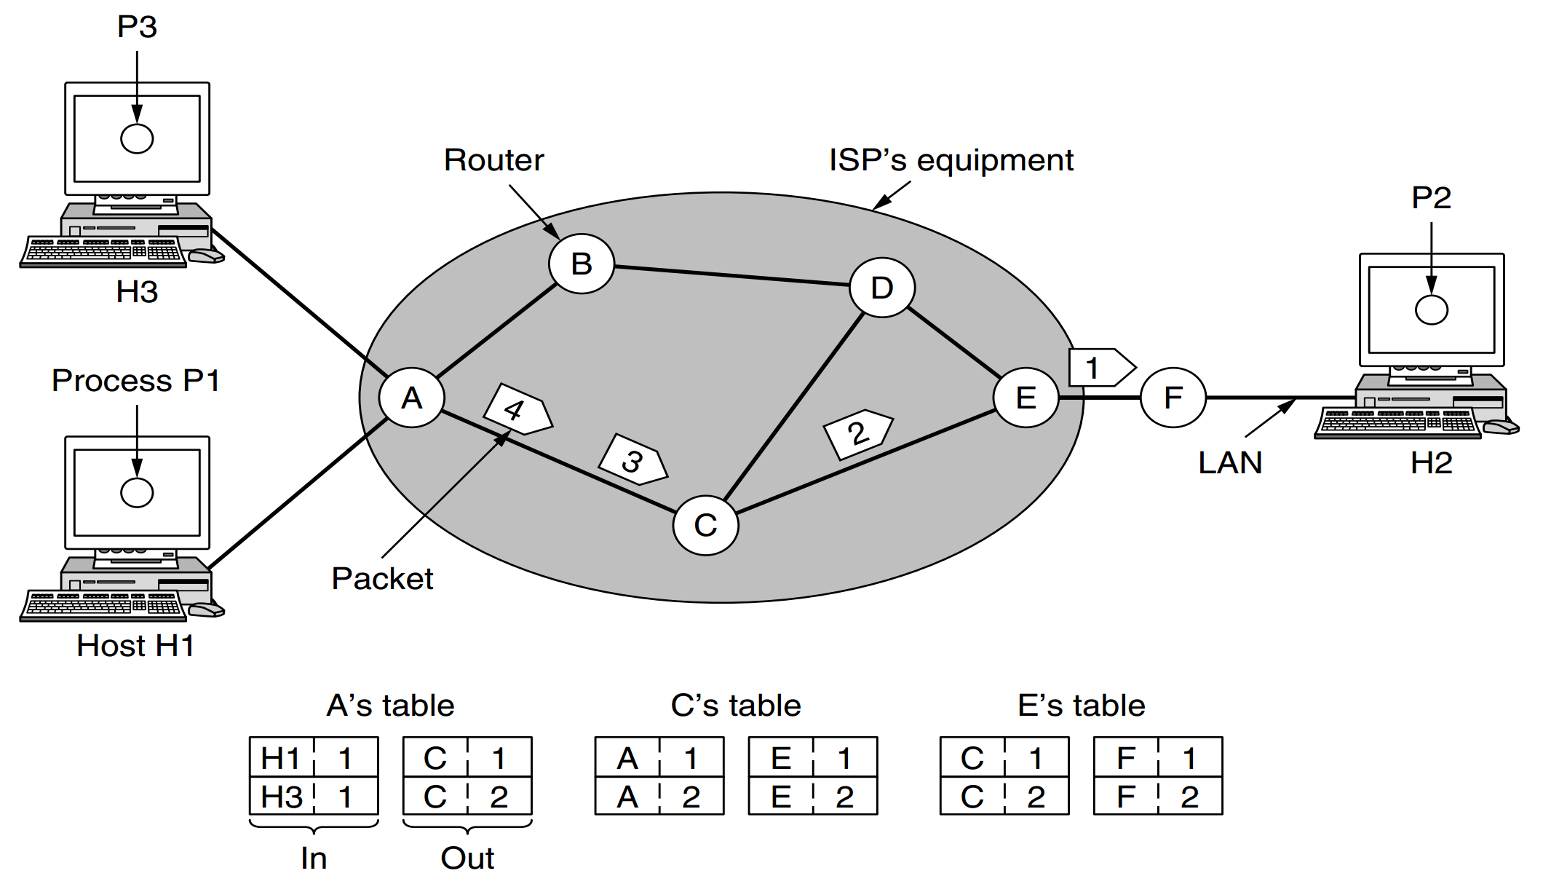
Routing
The main function of the network layer is routing packets from the source machine to the destination machine.
In most networks, packets will require multiple hops to make the journey.
The routing algorithm is that part of the network layer software responsible for deciding which output line an incoming packet should be transmitted on.
Routing algorithms can be grouped into two major classes:
nonadaptive and
adaptive.

Slide 74
Nonadaptive Routing
Nonadaptive algorithms do not base their routing decisions on any measurements or estimates of the current topology and traffic.
Instead, the choice of the route to use to get from I to J (for all I and J) is computed in advance, offline, and downloaded to the routers when the network is booted.
This procedure is sometimes called static routing

Slide 75
Adaptive Routing
Adaptive algorithms, in contrast, change their routing decisions to reflect changes in the topology, and sometimes changes in the traffic as well.
These dynamic routing algorithms differ in :
where they get their information (e.g., locally, from adjacent routers, or from all routers),
when they change the routes (e.g., when the topology changes, or every ΔT seconds as the load changes), and
what metric is used for optimization (e.g., distance, number of hops, or estimated transit time

Slide 76
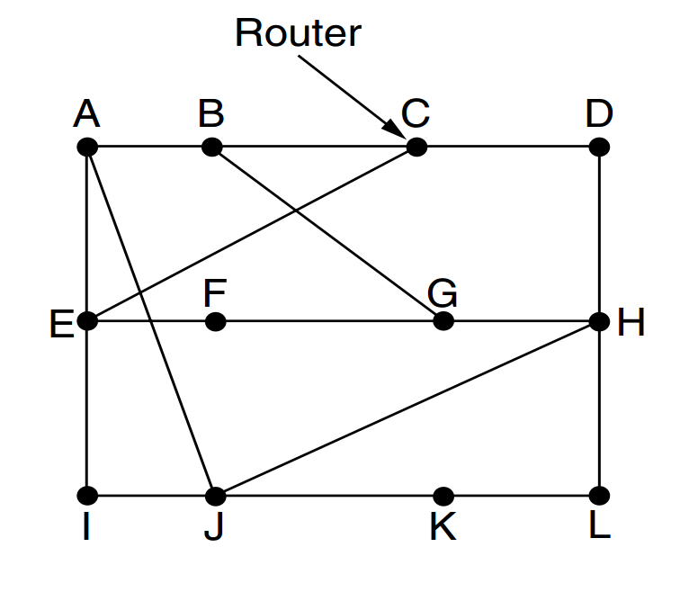
Optimality Principle
It states that if router J is on the optimal path from router I to router K then the optimal path from J to K also falls along the same route

Slide 77
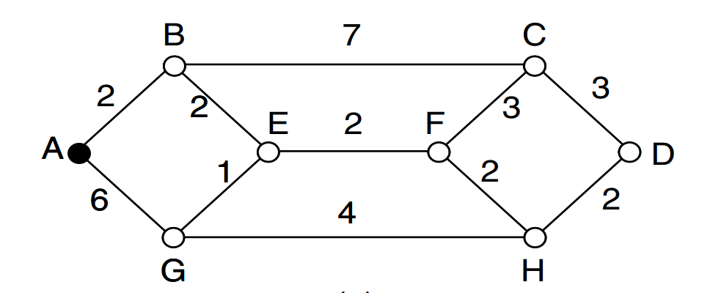
The Shortest Path Algorithm
One way of measuring path length is the number of hops. Using this metric, the paths ABC and ABE in Fig. 5-7 are equally long.
Another metric is the geographic distance in kilometers, in which case ABC is clearly much longer than ABE.
Dijkstra

Slide 78
Flooding
When a routing algorithm is implemented, each router must make decisions based on local knowledge, not the complete picture of the network.
A simple local technique is flooding, in which every incoming packet is sent out on every outgoing line except the one it arrived
D
S

Slide 79
Distance Vector Routing
A distance vector routing algorithm operates by having each router maintain a table (i.e., a vector) giving the best known distance to each destination and which link to use to get there.
These tables are updated by exchanging information with the neighbors. Eventually, every router knows the best link to reach each destination
As an example, assume that delay is used as a metric and that the router knows the delay to each of its neighbors

Slide 80
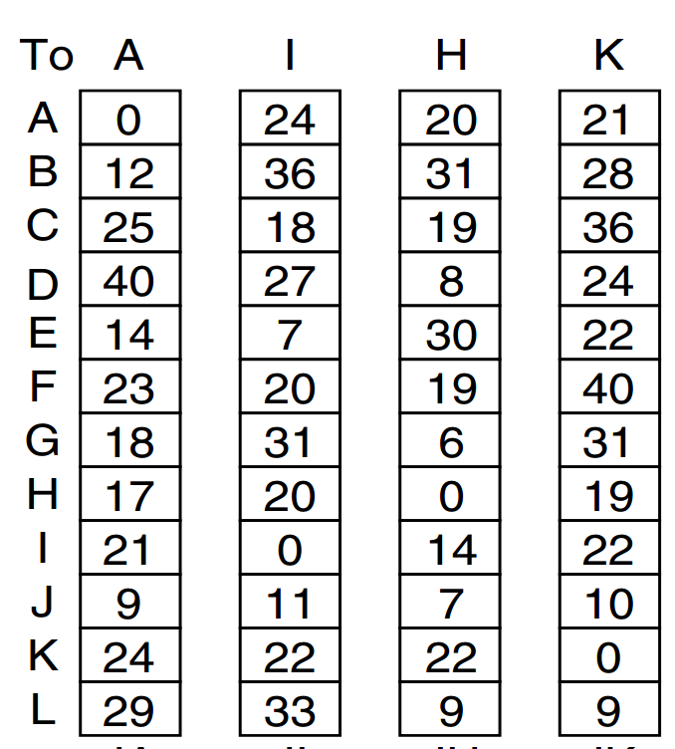
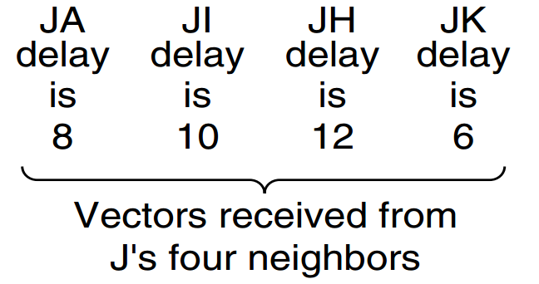
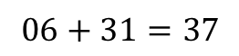
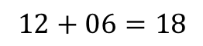
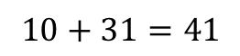
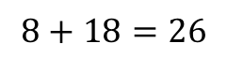
$$8+18=26$$
$$10+31=41$$
$$12+06=18$$
$$06+31=37$$
G: Send via A -18ms

Slide 81
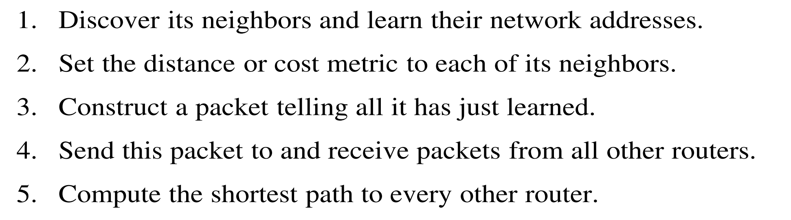
link state routing

Slide 82
ARP and RARP
Address Resolution Protocol (32bit IP to 48 bit MAC)
Reverse Address Resolution Protocol (48 bit MAC to 32 bit IP)

